Slide 1

Assignment - “1-D FIN WITH VOLUMETRIC HEATING”
Presented By:
1. Zeel Patel U21ME186
2. Lalithya Varshith U21ME225
(Year: 2023-24)
DEPARTMENT OF MECHANICAL ENGINEERING
Sardar Vallabhbhai National Institute of Technology

Slide 2
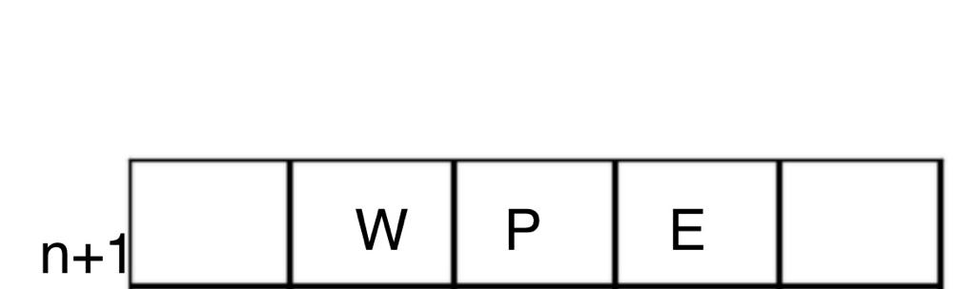
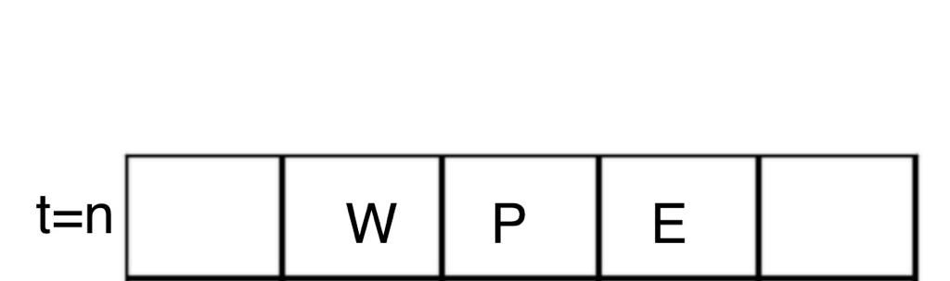
OBJECTIVE OF THE ASSIGNMENT
Develop a numerical code for obtaining unsteady temperature variation in a 1-D fin with bulk or volumetric heating. Generate results for all boundary conditions at both ends and different values of volumetric heating. The circumference of the fin is insulated. Use TDMA.

Slide 3

MODEL EQUATION AND BOUNDARY CONDITION
Energy conservation;
[𝑞 ̇(𝑥) − 𝑞 ̇(𝑥 + ∆𝑥)]𝐴 + S(A∆𝑥) = $\frac{∂(mCT)}{∂t}$
Where, A = Cross-sectional area of Fin p = Perimeter of fin
S= Volumetric heating rate $\dot{q }$= Conductive Heat flux $Δ$(mCT) = Change in Internal Energy
𝑞 ̇(𝑥 + ∆𝑥) = 𝑞 ̇(𝑥) − ∆𝑥( $\frac{∂\dot{q(x) }}{∂x}$ ) 𝑚𝐶𝑇 = (𝜌A∆𝑥)𝐶𝑇
𝜕(𝜌A∆𝑥𝐶𝑇) = − ∆𝑥𝐴 ( $\frac{∂\dot{q(x) }}{∂x}$ ) +S(∆𝑥𝐴)
Now, 𝑞̇(𝑥) = −𝑘 $\frac{∂T}{∂x}$
$ρC\frac{∂T}{∂t}=k\frac{∂^{2}T}{∂x^{2}}+S$
$ρ_{C}\iiint_{V}{\frac{∂T}{∂t}ⅆV}=\iiint_{V}{k\left(∇⋅\vec{∇_{T}}\right)ⅆV}+∭SⅆV$
$ρ_{C}\iiint_{V}{\frac{∂T}{∂t}ⅆV}=k\iint_{A}{∇\vec{T}⋅ⅆ\vec{A}}+∭SⅆV$
MODEL EQUATION

Slide 4
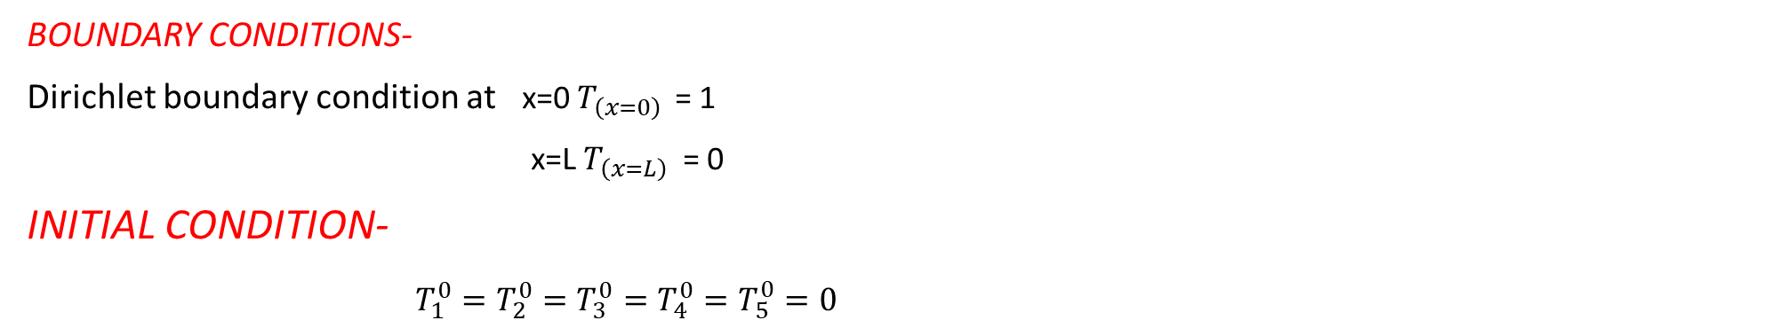
BOUNDARY CONDITIONS-
Dirichlet boundary condition at x=0 $T_{\left(x=0\right) }$= 1
x=L$T_{\left(x=L\right)}$ = 0
INITIAL CONDITION-
$T_{1}^{0}=T_{2}^{0}=T_{3}^{0}=T_{4}^{0}=T_{5}^{0}=0$

Slide 5

DISCRETISATION
Applying Implicit Time Marching,
$$ρc\left[\frac{T_{P}^{n+1}−T_{P}^{n}}{Δt}\right]=k\left[−\left(\frac{T_{P}^{n+1}−T_{W}^{n+1}}{Δx}\right)A+\left(\frac{T_{E}^{n+1}−T_{P}^{n+1}}{Δx}\right)A\right]+S(A∆x)$$
General Equation-
$a_{p}T_{P}^{n+1}+a_{W}T_{W}^{n+1}+a_{E}T_{E}^{n+1}=a_{p}^{0}T_{P}^{n}$ + S
Where,
$a_{p}=1+\frac{2αΔt}{Δx^{2}}$ (where $α=\frac{k}{ρc}$)
$a_{W}$= - $\frac{2αΔt}{Δx^{2}}$
$a_{E}$= - $\frac{ 2αΔt}{Δx^{2}}$
$a_{p}^{0}$ = 1
For cells(2 ≤ i ≤ (M-1))
$a_{i}T_{i}^{n+1}+a_{i−1}T_{i−1}^{n+1}+a_{i+1}T_{i+1}^{n+1}=a_{i}^{0}T_{i}^{n}$ + S

Slide 6
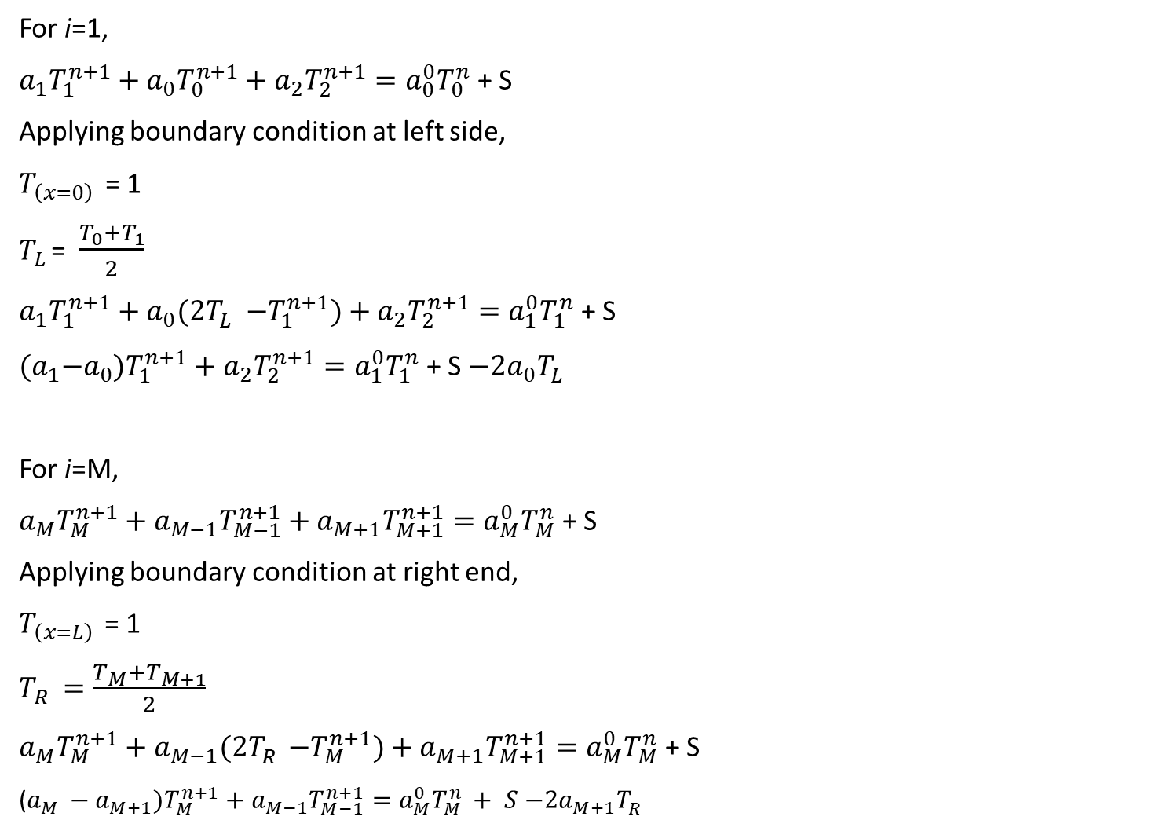
For i=1,
$a_{1}T_{1}^{n+1}+a_{0}T_{0}^{n+1}+a_{2}T_{2}^{n+1}=a_{0}^{0}T_{0}^{n}$ + S
Applying boundary condition at left side,
$T_{\left(x=0\right) }$= 1
$T_{L }$= $\frac{T_{0}+T_{1}}{2}$
$a_{1}T_{1}^{n+1}+a_{0}{(2T}_{L}^{}−T_{1}^{n+1})+a_{2}T_{2}^{n+1}=a_{1}^{0}T_{1}^{n}$ + S
${(a}_{1}−a_{0})T_{1}^{n+1}+a_{2}T_{2}^{n+1}=a_{1}^{0}T_{1}^{n}$ + S $−{2a}_{0}T_{L}^{}$
For i=M,
$a_{M}T_{M}^{n+1}+a_{M−1}T_{M−1}^{n+1}+a_{M+1}T_{M+1}^{n+1}=a_{M}^{0}T_{M}^{n}$ + S
Applying boundary condition at right end,
$T_{\left(x=L\right) }$= 1
$T_{R}$ $=\frac{T_{M}+T_{M+1}}{2}$
$a_{M}T_{M}^{n+1}+a_{M−1}{(2T}_{R}^{}−T_{M}^{n+1})+a_{M+1}T_{M+1}^{n+1}=a_{M}^{0}T_{M}^{n}$ + S
($a_{M }−a_{M+1})T_{M}^{n+1}+a_{M−1}T_{M−1}^{n+1}=a_{M}^{0}T_{M }^{n}+ S$ $−{2a}_{M+1}T_{R}^{}$

Slide 7

SAMPLE CALCULATION ( DIRICHLET BOUNDARY CONDITION)
L=1 M=5 $α=\frac{k}{ρc}$=1 $Δt=0.01$ $Δx=0.2$
$T_{L }=1 T_{R}=0$
$T_{1}^{0}=T_{2}^{0}=T_{3}^{0}=T_{4}^{0}=T_{5}^{0}=0$ INITIAL CONDITION
S= Volumetric Heating Rate= 0.01
$a_{p}=1+\frac{2αΔt}{Δx^{2}}$ = 1.5
$a_{W}$ = - $\frac{2αΔt }{Δx^{2}}$ = -0.25
$a_{E}$= - $\frac{ 2αΔt}{Δx^{2}}$ = -0.25
$a_{p}^{0}$ = 1
5 equations for 5 unknown values-
${(a}_{P}−a_{W})T_{1}^{n+1}+a_{E}T_{2}^{n+1}=a_{P}^{0}T_{1}^{n}$ + S $−{2a}_{W}T_{L}^{}$
$a_{P}T_{2}^{n+1}+a_{W}T_{1}^{n+1}+a_{E}T_{3}^{n+1}=a_{P}^{0}T_{2}^{n}$ + S
$a_{P}T_{3}^{n+1}+a_{W}T_{2}^{n+1}+a_{E}T_{4}^{n+1}=a_{P}^{0}T_{3}^{n}$ + S
$a_{P}T_{4}^{n+1}+a_{W}T_{3}^{n+1}+a_{E}T_{5}^{n+1}=a_{P}^{0}T_{4}^{n}$ + S
($a_{P }−a_{E})T_{5}^{n+1}+a_{W}T_{4}^{n+1}=a_{P}^{0}T_{5 }^{n}+ S$ $−{2a}_{E}T_{R}^{}$

Slide 8
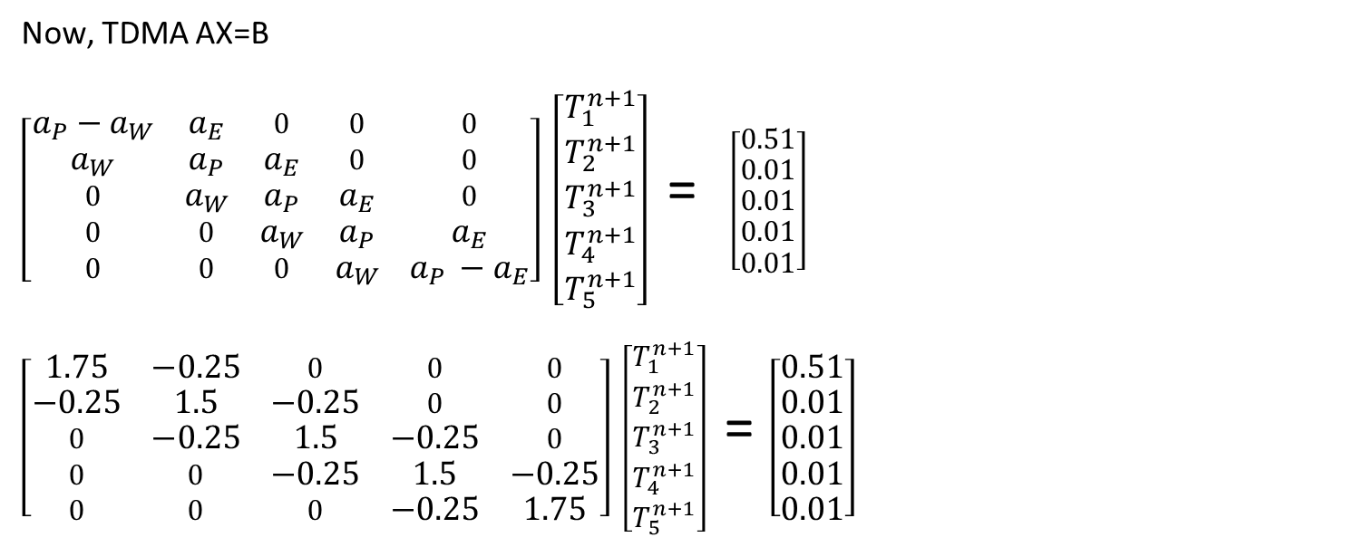
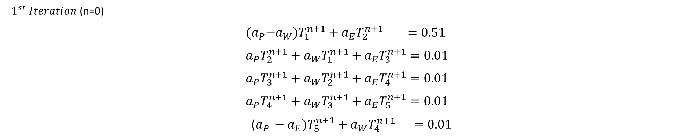
$1^{st} Iteration$ (n=0)
$${(a}_{P}−a_{W})T_{1}^{n+1}+a_{E}T_{2}^{n+1} =0.51$$
$$a_{P}T_{2}^{n+1}+a_{W}T_{1}^{n+1}+a_{E}T_{3}^{n+1}=0.01$$
$$a_{P}T_{3}^{n+1}+a_{W}T_{2}^{n+1}+a_{E}T_{4}^{n+1}=0.01$$
$$a_{P}T_{4}^{n+1}+a_{W}T_{3}^{n+1}+a_{E}T_{5}^{n+1}=0.01$$
($a_{P }−a_{E})T_{5}^{n+1}+a_{W}T_{4}^{n+1} =0.01$
Now, TDMA AX=B
$\left[\begin{matrix}a_{P}−a_{W} & a_{E} & 0 & 0 & 0 \\ a_{W} & a_{P} & a_{E} & 0 & 0 \\ 0 & a_{W} & a_{P} & a_{E} & 0 \\ 0 & 0 & a_{W} & a_{P} & a_{E} \\ 0 & 0 & 0 & a_{W} & a_{P }−a_{E}\end{matrix}\right]$ $\left[\begin{matrix}T_{1}^{n+1} \\ T_{2}^{n+1} \\ T_{3}^{n+1} \\ T_{4}^{n+1} \\ T_{5}^{n+1}\end{matrix}\right]$ = $\left[\begin{matrix}0.51 \\ 0.01 \\ 0.01 \\ 0.01 \\ 0.01\end{matrix}\right]$
$\left[\begin{matrix}1.75 & −0.25 & 0 & 0 & 0 \\ −0.25 & 1.5 & −0.25 & 0 & 0 \\ 0 & −0.25 & 1.5 & −0.25 & 0 \\ 0 & 0 & −0.25 & 1.5 & −0.25 \\ 0 & 0 & 0 & −0.25 & 1.75\end{matrix}\right]$ $\left[\begin{matrix}T_{1}^{n+1} \\ T_{2}^{n+1} \\ T_{3}^{n+1} \\ T_{4}^{n+1} \\ T_{5}^{n+1}\end{matrix}\right]$ = $\left[\begin{matrix}0.51 \\ 0.01 \\ 0.01 \\ 0.01 \\ 0.01\end{matrix}\right]$

Slide 9
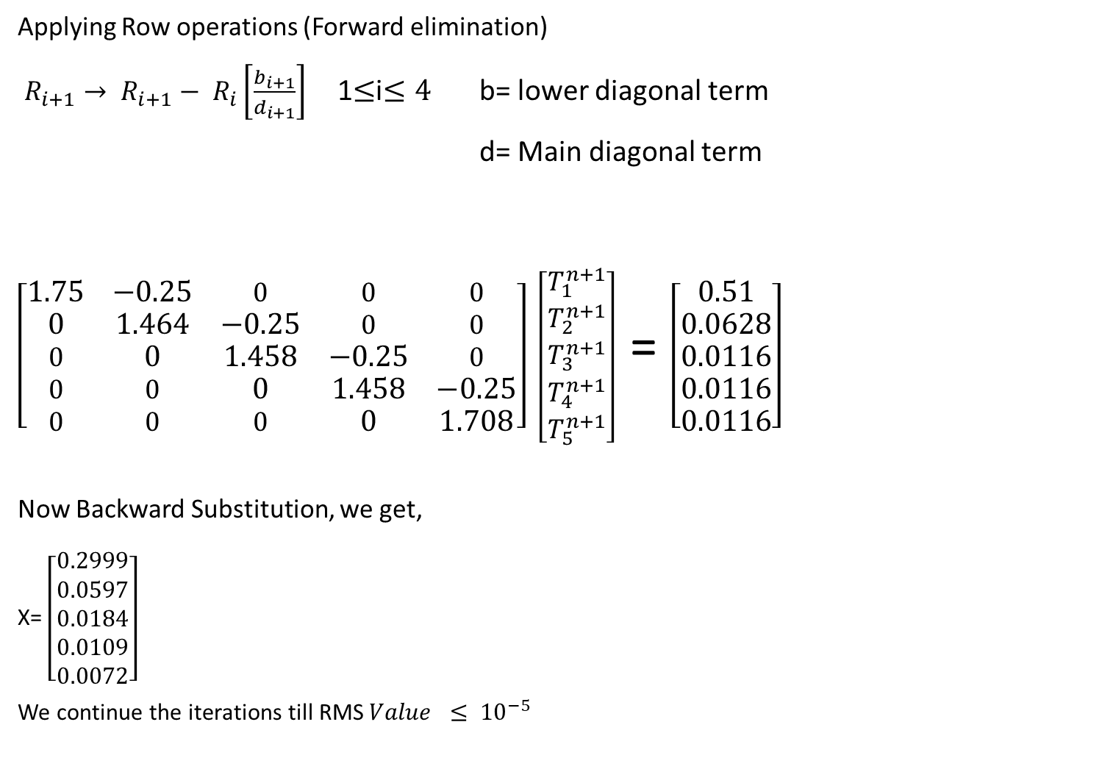
Applying Row operations (Forward elimination)
$R_{i+1}→ R_{i+1}− R_{i}\left[\frac{b_{i+1}}{d_{i+1}}\right]$ 1$≤$i$≤4$ b= lower diagonal term
d= Main diagonal term
$\left[\begin{matrix}1.75 & −0.25 & 0 & 0 & 0 \\ 0 & 1.464 & −0.25 & 0 & 0 \\ 0 & 0 & 1.458 & −0.25 & 0 \\ 0 & 0 & 0 & 1.458 & −0.25 \\ 0 & 0 & 0 & 0 & 1.708\end{matrix}\right]$ $\left[\begin{matrix}T_{1}^{n+1} \\ T_{2}^{n+1} \\ T_{3}^{n+1} \\ T_{4}^{n+1} \\ T_{5}^{n+1}\end{matrix}\right]$ = $\left[\begin{matrix}0.51 \\ 0.0628 \\ 0.0116 \\ 0.0116 \\ 0.0116\end{matrix}\right]$
Now Backward Substitution, we get,
X= $\left[\begin{matrix}0.2999 \\ 0.0597 \\ 0.0184 \\ 0.0109 \\ 0.0072\end{matrix}\right]$
We continue the iterations till RMS$Value ≤ {10}^{−5}$

Slide 10

SAMPLE CALCULATION ( ROBIN’S BOUNDARY CONDITION)
Robin’s Boundary Condition on right side
We get,
For i=M,
$a_{M}T_{M}^{n+1}+a_{M−1}T_{M−1}^{n+1}+a_{M+1}T_{M+1}^{n+1}=a_{M}^{0}T_{M}^{n}$ + S
Applying boundary condition,
$${\left.\frac{∂T}{∂x}\right|}_{x=l,t}=−\frac{h}{k}\left[T_{x=L,t}−T∞\right]$$
$$\frac{T_{M+1}^{n+1}−T_{M}^{n}}{Δx}=−\frac{h}{k}\left[\frac{T_{M+1}^{n+1}+T_{M}^{n}}{2}−T∞\right]$$
$$T_{M+1}^{n+1}=AT_{M}^{n+1}+B$$
A = $\frac{1−\frac{hΔx}{2k}}{1+\frac{hΔx}{2k}}$
B= $\frac{\frac{hΔx}{2k}T∞}{1+\frac{hΔx}{2k}}$
$a_{M}T_{M}^{n+1}+a_{M−1}T_{M−1}^{n+1}+a_{M+1}{(AT}_{M}^{n+1}+B)=a_{M}^{0}T_{M}^{n}$ + S
$(a_{M}+{Aa}_{M+1})T_{M}^{n+1}+a_{M−1}T_{M−1}^{n+1}=a_{M}^{0}T_{M}^{n}$ + S - $Ba_{M+1}$

Slide 11

L=1 M=5 $α=\frac{k}{ρc}$=1 $Δt=0.01$ $Δx=0.2$
$T_{L }=1$ $T_{R}=0$
h/2k =1
$T_{1}^{0}=T_{2}^{0}=T_{3}^{0}=T_{4}^{0}=T_{5}^{0}=0 T∞=0.1$
S= Volumetric Heating Rate= 0.01
$a_{p}=1+\frac{2αΔt}{Δx^{2}}$ = 1.5
$a_{w}$ = - $\frac{2αΔt }{Δx^{2}}$ = -0.25
$a_{E}$= - $\frac{ 2αΔt}{Δx^{2}}$ = -0.25
$a_{p}^{0}$ = 1
5 equations for 5 unknown values-
${(a}_{P}−a_{W})T_{1}^{n+1}+a_{E}T_{2}^{n+1}=a_{P}^{0}T_{1}^{n}$ + S $−{2a}_{W}T_{L}^{}$
$a_{P}T_{2}^{n+1}+a_{W}T_{1}^{n+1}+a_{E}T_{3}^{n+1}=a_{P}^{0}T_{2}^{n}$ + S
$a_{P}T_{3}^{n+1}+a_{W}T_{2}^{n+1}+a_{E}T_{4}^{n+1}=a_{P}^{0}T_{3}^{n}$ + S
$a_{P}T_{4}^{n+1}+a_{W}T_{3}^{n+1}+a_{E}T_{5}^{n+1}=a_{P}^{0}T_{4}^{n}$ + S
$(a_{P}+{Aa}_{E})T_{5}^{n+1}+a_{W}T_{4}^{n+1}=a_{5}^{0}T_{5}^{n}$ + S - $Ba_{E}$

Slide 12
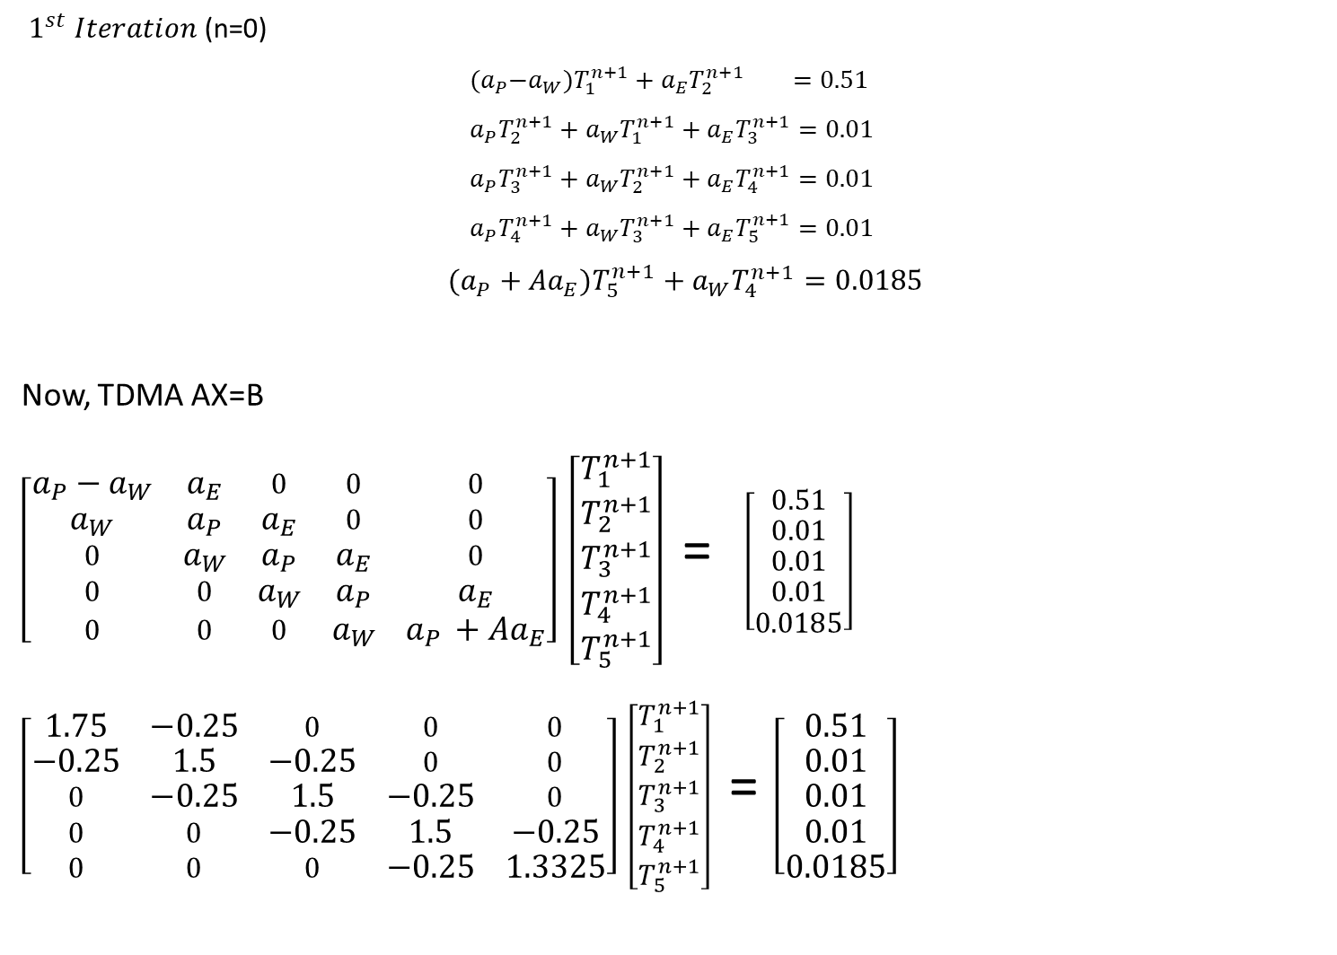
$1^{st} Iteration$ (n=0)
$${(a}_{P}−a_{W})T_{1}^{n+1}+a_{E}T_{2}^{n+1} =0.51$$
$$a_{P}T_{2}^{n+1}+a_{W}T_{1}^{n+1}+a_{E}T_{3}^{n+1}=0.01$$
$$a_{P}T_{3}^{n+1}+a_{W}T_{2}^{n+1}+a_{E}T_{4}^{n+1}=0.01$$
$$a_{P}T_{4}^{n+1}+a_{W}T_{3}^{n+1}+a_{E}T_{5}^{n+1}=0.01$$
$(a_{P}+{Aa}_{E})T_{5}^{n+1}+a_{W}T_{4}^{n+1}=0.0185$
Now, TDMA AX=B
$\left[\begin{matrix}a_{P}−a_{W} & a_{E} & 0 & 0 & 0 \\ a_{W} & a_{P} & a_{E} & 0 & 0 \\ 0 & a_{W} & a_{P} & a_{E} & 0 \\ 0 & 0 & a_{W} & a_{P} & a_{E} \\ 0 & 0 & 0 & a_{W} & a_{P }+Aa_{E}\end{matrix}\right]$ $\left[\begin{matrix}T_{1}^{n+1} \\ T_{2}^{n+1} \\ T_{3}^{n+1} \\ T_{4}^{n+1} \\ T_{5}^{n+1}\end{matrix}\right]$ = $\left[\begin{matrix}0.51 \\ 0.01 \\ 0.01 \\ 0.01 \\ 0.0185\end{matrix}\right]$
$\left[\begin{matrix}1.75 & −0.25 & 0 & 0 & 0 \\ −0.25 & 1.5 & −0.25 & 0 & 0 \\ 0 & −0.25 & 1.5 & −0.25 & 0 \\ 0 & 0 & −0.25 & 1.5 & −0.25 \\ 0 & 0 & 0 & −0.25 & 1.3325\end{matrix}\right]$ $\left[\begin{matrix}T_{1}^{n+1} \\ T_{2}^{n+1} \\ T_{3}^{n+1} \\ T_{4}^{n+1} \\ T_{5}^{n+1}\end{matrix}\right]$ = $\left[\begin{matrix}0.51 \\ 0.01 \\ 0.01 \\ 0.01 \\ 0.0185\end{matrix}\right]$

Slide 13
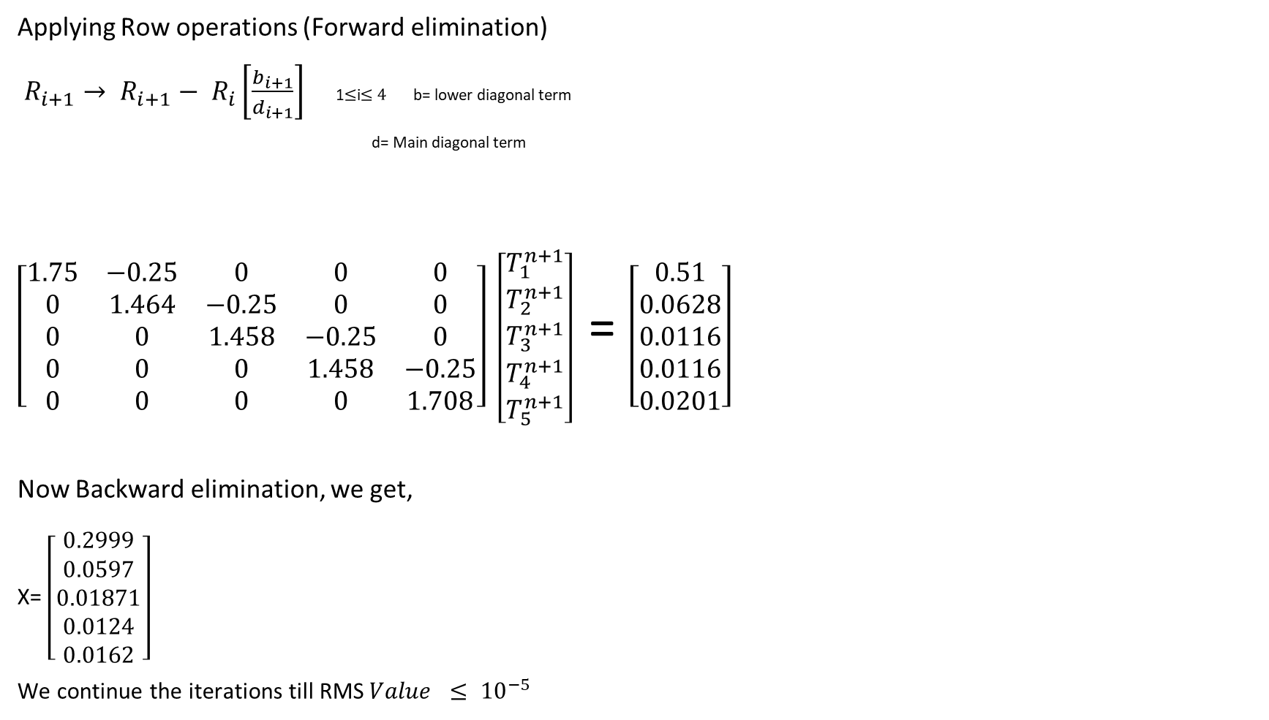
Applying Row operations (Forward elimination)
$R_{i+1}→ R_{i+1}− R_{i}\left[\frac{b_{i+1}}{d_{i+1}}\right]$ 1$≤$i$≤4$ b= lower diagonal term
d= Main diagonal term
$\left[\begin{matrix}1.75 & −0.25 & 0 & 0 & 0 \\ 0 & 1.464 & −0.25 & 0 & 0 \\ 0 & 0 & 1.458 & −0.25 & 0 \\ 0 & 0 & 0 & 1.458 & −0.25 \\ 0 & 0 & 0 & 0 & 1.708\end{matrix}\right]$ $\left[\begin{matrix}T_{1}^{n+1} \\ T_{2}^{n+1} \\ T_{3}^{n+1} \\ T_{4}^{n+1} \\ T_{5}^{n+1}\end{matrix}\right]$ = $\left[\begin{matrix}0.51 \\ 0.0628 \\ 0.0116 \\ 0.0116 \\ 0.0201\end{matrix}\right]$
Now Backward elimination, we get,
X= $\left[\begin{matrix}0.2999 \\ 0.0597 \\ 0.01871 \\ 0.0124 \\ 0.0162\end{matrix}\right]$
We continue the iterations till RMS$Value ≤ {10}^{−5}$

Slide 14
CODE FOR DIRICHLET BOUNDARY CONDITION (TDMA)
//#include<iostream>
#include<stdio.h>
#include<math.h>
#include<conio.h>
#include<io.h>
#define nx 20 //number of cells
//using namespace std;
double x[nx+10],T[nx+10],Told[nx+10],d[nx+10],a[nx+10],b[nx+10],R[nx+10];
main()
{
mkdir("TDMA");
int i,step;
double L,dx,A,dt,TH,TC,ap,aw,ae,a0,rms,residue,S;
printf("enter the value of volumetric heating rate S= ");
scanf("entered value of S=%lf, &S");
L = 1.0; //length of domain
A = 1.0; //alpha
dt = 0.01; //time-step
TH = 1.0; //left wall temperature
TC = 0.0; //right wall temperature
residue = 0.000001; //residue
//S= 0.01;
//------------grid generation---------------//
dx = L/nx;
x[1] = 0.5*dx;
x[0] = 0.0;
x[nx+1] = L;
for(i=2;i<=nx;i++)
x[i] = x[i-1] + dx;
//----------coefficients-------------//
ap = (1+((2*A*dt)/(dx*dx)));
aw = (-1)*((A*dt)/(dx*dx));
ae = (-1)*((A*dt)/(dx*dx));
a0 = 1.0;
//-------initialisation----------//
for(i=1;i<=nx;i++)
{
T[i] = 0.0;
Told[i]=0.0;
}
//---------iterative calculation with TDMA-------------//
step = 1;
do
{
for(i=1;i<=nx-1;i++) //above diagonal
a[i] = ae;
for(i=2;i<=nx;i++) //below diagonal
b[i] = aw;
d[1] = (ap-aw); //main diagonal
d[nx] = (ap-ae);
for(i=2;i<=nx-1;i++)
d[i] = ap;
R[1] = ((a0*T[1])-(2*TH*aw)+S); //B matirx in AX=B
R[nx] = ((a0*T[nx])-(2*TC*ae)+S);
for(i=2;i<=nx;i++)
R[i] = a0*T[i]+S;

Slide 15
rms = sqrt(sum/nx);
if (step%1==0)
{
char filename[1000]; //////size of charecter
FILE*f2;
sprintf(filename,"TDMA\\%d.dat",step);
f2=fopen(filename,"w");
fprintf(f2,"VARIABLES=X,T\n");
fprintf(f2,"\nZONE T=\"0\" i=%d, ZONETYPE=ORDERED,DATAPACKING=POINT\n",nx);
for (i=1;i<=nx;i++)
{
{
fprintf(f2,"%f\t%.10f\n ",x[i],T[i]);
}
}
fclose(f2);
}
step++;
}
while(rms>residue);
//printf("%d",step);
//-------------file writing------------//
FILE *f1;
//for(i=0;i<=nx;i++)
{
f1 = fopen("temp.dat","w");
fprintf(f1,"VARIABLES=""X"",""TEMPERATURE""\nZONE I=%d ZONETYPE=ORDERED DATAPACKING=POINT\n",nx+2);
for(i=0;i<=nx+1;i++)
fprintf(f1,"%lf\t%lf\n",x[i],T[i]);
}
fclose(f1);
return 0;
}
for(i=2;i<=nx;i++) //forward sweep
{
d[i] = (d[i] - ((b[i]/d[i-1])*a[i-1]));
R[i] = (R[i] - ((b[i]/d[i-1])*R[i-1]));
}
T[nx] = R[nx]/d[nx]; //backword sweep
for(i=nx-1;i>0;i--)
T[i] = ((R[i] - (a[i]*T[i+1]))/d[i]);
T[0] = TH;
T[nx+1] = TC;
double sum = 0.0; //rms calulation
for(i=1;i<=nx;i++)
{
sum = sum + pow((Told[i]-T[i]),2);
Told[i]=T[i];
printf("%d\t%lf\t%lf\n",step,rms,T[i]);
}

Slide 16
CODE TDMA ROBIN’S BOUNDARY CONDITION
//#include<iostream>
#include<stdio.h>
#include<math.h>
#include<conio.h>
#include<io.h>
#define nx 20 //number of cells
//using namespace std;
double x[nx+10],T[nx+10],Told[nx+10],d[nx+10],a[nx+10],b[nx+10],R[nx+10];
main()
{
mkdir("TEST");
int i,step;
double L,dx,A,dt,TH,TC,ap,aw,ae,a0,rms,residue,S,Ts,h,k;
printf("enter the value of volumetric heating rate S= ");
scanf("entered value of S=%lf”, &S);
L = 1.0; //length of domain
A = 1.0; //alpha
dt = 0.01; //time-step
TH = 1.0; //left wall temperature
//TC = 0.0; //right wall temperature
residue = 0.000001; //residue
//S= 0.01;
Ts=0.1;
h=1;
k=0.5;
//------------grid generation---------------//
dx = L/nx;
x[1] = 0.5*dx;
x[0] = 0.0;
x[nx+1] = L;
for(i=2;i<=nx;i++)
x[i] = x[i-1] + dx;
//----------coefficients-------------//
ap = (1+((2*A*dt)/(dx*dx)));
aw = (-1)*((A*dt)/(dx*dx));
ae = (-1)*((A*dt)/(dx*dx));
a0 = 1.0;
//-------initialisation----------//
for(i=1;i<=nx;i++)
{
T[i] = 0.0;
Told[i]=0.0;
}

Slide 17
//---------iterative calculation with TDMA-------------//
step = 1;
do
{
for(i=1;i<=nx-1;i++) //above diagonal
a[i] = ae;
for(i=2;i<=nx;i++) //below diagonal
b[i] = aw;
d[1] = (ap-aw); //main diagonal
d[nx] = (ap+((2*k-h*dx)/(2*k+h*dx)*ae));
for(i=2;i<=nx-1;i++)
d[i] = ap;
R[1] = ((a0*T[1])-(2*TH*aw)+S); //B matirx in AX=B
R[nx] = ((a0*T[nx])-((2*h*dx)/(2*k+h*dx)*ae*Ts)+S);
for(i=2;i<=nx-1;i++)
R[i] = a0*T[i]+S;
for(i=2;i<=nx;i++) //forward sweep
{
d[i] = (d[i] - ((b[i]/d[i-1])*a[i-1]));
R[i] = (R[i] - ((b[i]/d[i-1])*R[i-1]));
}
T[nx] = R[nx]/d[nx]; //backword sweep
for(i=nx-1;i>0;i--)
T[i] = ((R[i] - (a[i]*T[i+1]))/d[i]);
T[0] = TH;
T[nx+1] = TC;
double sum = 0.0; //rms calulation
for(i=1;i<=nx;i++)
{
sum = sum + pow((Told[i]-T[i]),2);
Told[i]=T[i];
printf("%d\t%lf\t%lf\n",step,rms,T[i]);
}
rms = sqrt(sum/nx);
if (step%1==0)
{
char filename[1000]; //////size of charecter
FILE*f2;
sprintf(filename,"TEST\\%d.dat",step);
f2=fopen(filename,"w");
fprintf(f2,"VARIABLES=X,T\n");
fprintf(f2,"\nZONE T=\"0\" i=%d, ZONETYPE=ORDERED,DATAPACKING=POINT\n",nx);
for (i=1;i<=nx;i++)
{
{
fprintf(f2,"%f\t%.10f\n ",x[i],T[i]);
}
}
fclose(f2);
}
step++;
}
while(rms>residue);
//printf("%d",step);
//-------------file writing------------//
FILE *f1;
//for(i=0;i<=nx;i++)
{
f1 = fopen("temp.dat","w");
fprintf(f1,"VARIABLES=""X"",""TEMPERATURE""\nZONE I=%d ZONETYPE=ORDERED DATAPACKING=POINT\n",nx+2);
for(i=0;i<=nx+1;i++)
fprintf(f1,"%lf\t%lf\n",x[i],T[i]);
}
fclose(f1);
return 0;
}

Slide 18
CODE FOR TEMPERATURE PROFILE
maxIterations=280
# Specify the output file format and name
set terminal pngcairo
set output "temperature_plots.png"
# Define plot style and labels
set xlabel "X"
set ylabel "Temperature"
set title "Temperature Variation over different volumetric heating rate(robin's)"
# Set a smaller legend size
#set key samplen 1 spacing 1
# Plot data from multiple files using a loop
#plot for [i=0:maxIterations] 'TEST/'.i.'.dat' using 1:2 with lines title 'S=0.0'.i
plot for [i=0:maxIterations] 'TEST/'.i.'.dat' using 1:2 with lines notitle

Slide 19
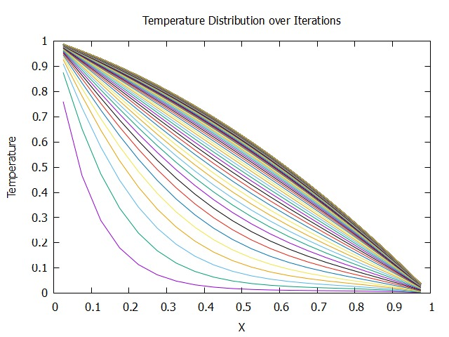
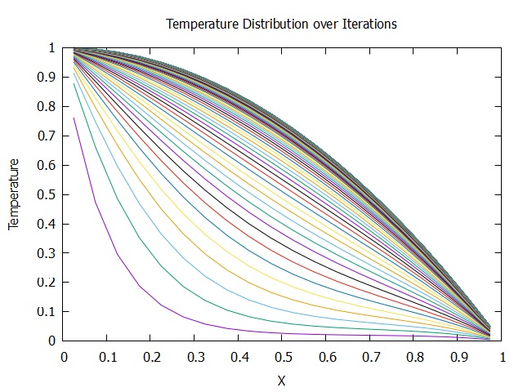
RESULT (DIRICHLET)
S=0.01
S=0.02

Slide 20
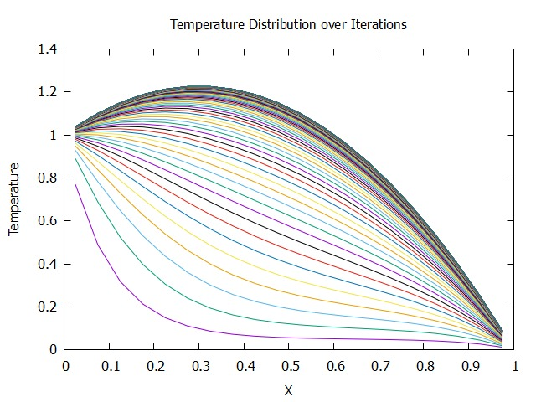
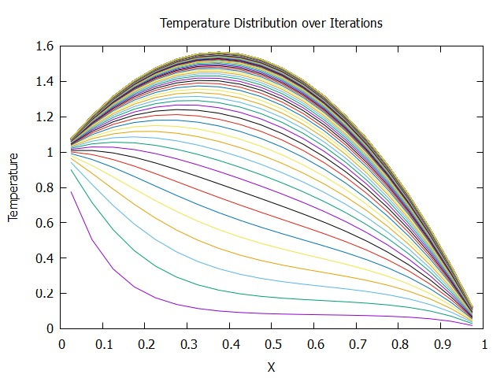
S=0.05
S=0.08

Slide 21
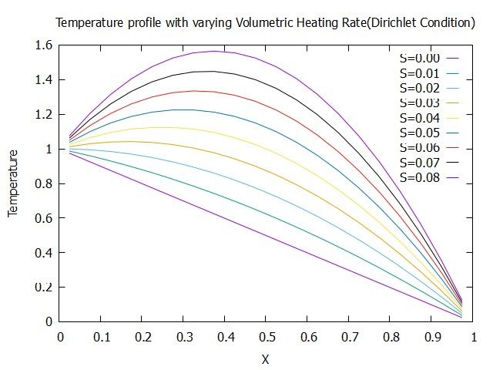
As the volumetric heating rate increases, the maxima shifts further upwards

Slide 22
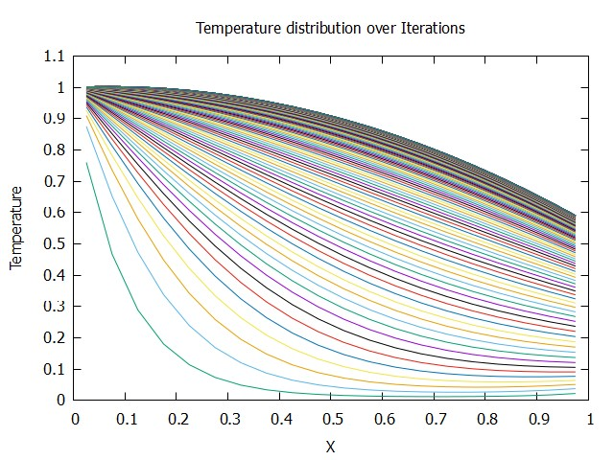
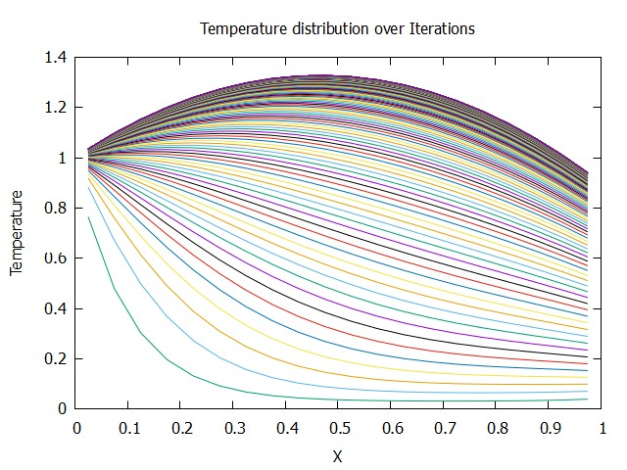
RESULT (ROBIN’S)
S=0.01
S=0.03

Slide 23
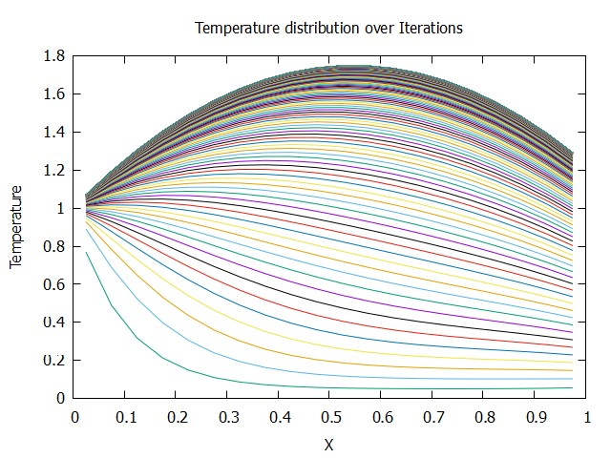
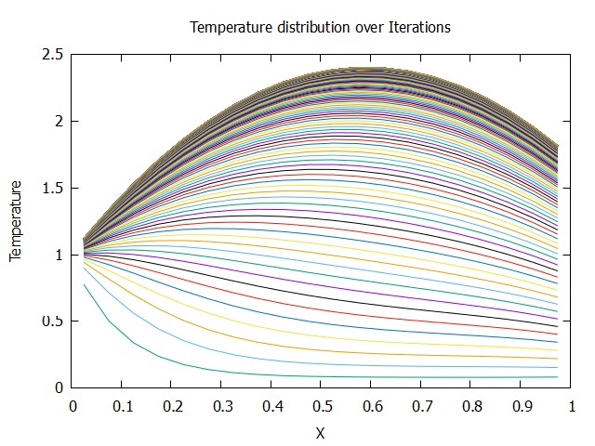
S=0.05
S=0.08

Slide 24
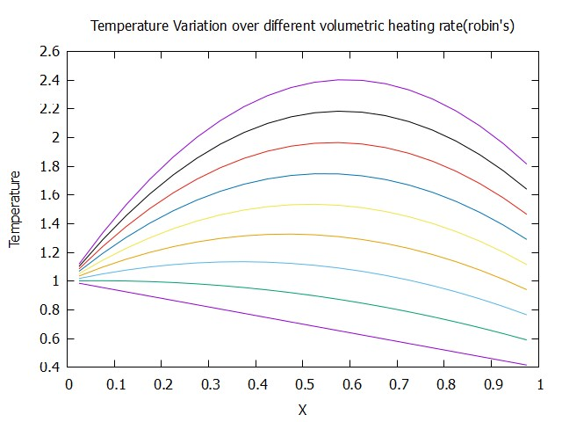
S=0.08
S=0.07
S=0.06
S=0.05
S=0.04
S=0.03
S=0.02
S=0.01
S=0.00
As the volumetric heating rate increases, the maxima shifts further upwards

Slide 25
CONCLUSION
As the volumetric heating rate increases, the maxima shifts further upwards.
Use of Dirichlet boundary condition and circumferential insulation had a profound impact on temperature distribution.
If the right side of the 1D fin is subjected to a Robin boundary condition while maintaining the Dirichlet condition on the left. The transition from a Dirichlet to a Robin boundary condition on one side introduces a more complex thermal interaction, allowing for a heat transfer coefficient to influence the temperature profile at that boundary.
The shift in the location of the temperature maximum with increasing volumetric heating rate would typically be more pronounced in the Robin boundary condition case compared to the Dirichlet case.
In the Dirichlet boundary condition, the temperature at the boundary is fixed, and the heat accumulates within the fin, leading to a more gradual change in temperature distribution as the volumetric heating rate increases.
In the Robin boundary condition, the right-side temperature is influenced by the heat transfer coefficient and the temperature difference between the fin and its surroundings. As the volumetric heating rate increases, the higher heat generation causes a more significant temperature difference, which in turn affects the right-side temperature more significantly.

Slide 26
THANK YOU!

